Slide 1
Predict Active Nicotine Users
ALY6020 Winter 2019 Final Project
Instructor: Andrew Long
Minyi Chen
2/16/2019

Slide 2
Introduction
Project definition: predict if a person is an active Nicotine User
Predictive model
Drug consumption dataset from UCI Machine Learning Repository
Non-active users = users consume in the last decade, over a decade ago, or never used
Active Users = consume Nicotine in the last year, month, week, or day
56.2%
P
or
N

Slide 3
Data and methods

Slide 4
Data Sample size: 1885 participants, feature number: 32, survey data collected 03/2011 to 03/2012
Demographics
Personality traits
Drug consumption
neuroticism (Nscore)
Age
Alcohol
Heroin
Nicotine
…
extraversion (Escore)
openness to experience (Oscore)
agreeableness (Ascore)
conscientiousness (Cscore)
impulsiveness
Sensation-seeking(SS)
Gender
Education
Country
Race

Slide 5
Input feature engineering
No missing value
Numerical features (7)
Ordinal features (4)
7 personality traits: N, E, O, A, C, I, SS
Education: 9 unique values
Heroin: 7 unique values
Alcohol: 7 unique values
Age: 6 unique values
Categorical features (13)
Race (6)
Gender
Country (6)
One-hot encoding

Slide 6
Build training/validation/test set
We will split into 70% train, 15% validation, 15% test.
Use training data set to train our model, validation data set to see how we can improve our model, test data set to see how well the model performs.
Train all prevalence(n = 1319):0.577
Valid prevalence(n = 283):0.537
Test prevalence(n = 283):0.519

Slide 7
Classification methods
K Nearest Neighbors (KNN)
Logistic Regression (LR)
Stochastic Gradient Descent (SGD)
Naïve Bayes (NB)
Decision Tree (DT)
Random Forest (RF)
Gradient Boosting (GB)
Use AUC to select the best model
- AUC does not require us selecting a threshold and helps balance true positive rate and false positive rate.

Slide 8
Results

Slide 9
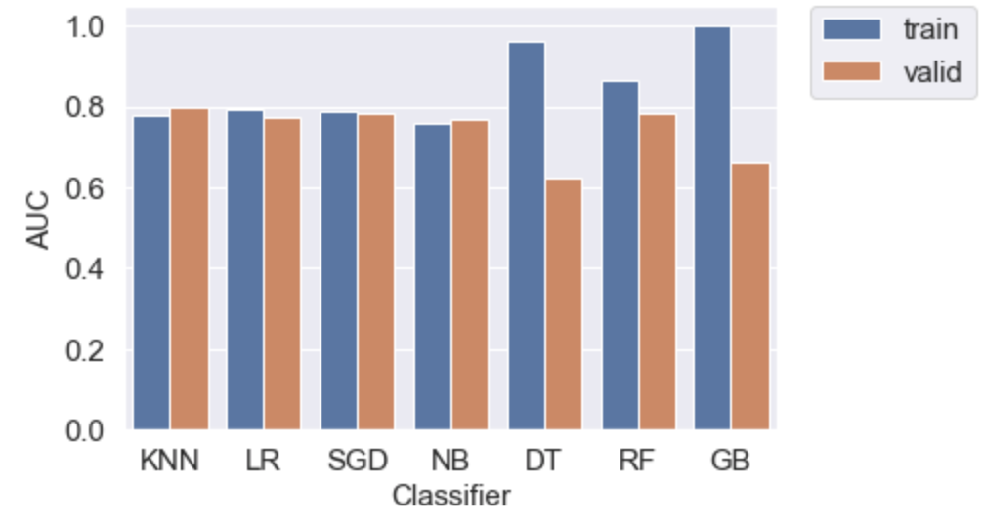
Baseline models
Random forest model has an AUC of 0.782 that catches 78% of the active Nicotine users with a threshold of 0.5.
Overfitting (high variance): decision tree, gradient boosting models, random forest.
Underfitting (Bias): KNN, Logistic, SGD, NB.

Slide 10
Best baseline model: Random Forest
Problems: Overfitting (high variance)
Techniques:
Add more samples
Add regularization
Reduce number of features
Decrease model complexity
Add better features
Change model architecture
Source: Andrew Ng's Coursera class paraphrased on https://www.learnopencv.com/bias-variance-tradeoff-in-machine-learning/
and Andrew Ng's Machine Learning Yearning textbook.

Slide 11
Input feature importance of Logistic Regression
Positive Feature Importance:
SS, C_RepofIreland, Oscore, C_USA, heroin, alcohol, C_Other, Nscore, Ascore, C_Canada
Negative Feature Importance:
Age, Education, C_NewZealand, Cscore, R_Black/Asian, R_White, R_Black, R_White/Asian, Female, R_Other, R_Asian, Escore, C_UK
Notes:
SS: high risk behavior, Impulsive: act without thinking, N: negative emotion such as anxiety, E: outgoing, talkative, etc. O: wide interests, etc. A: kindness, etc. C: organized, reliable, etc.

Slide 12
Input feature importance of Random Forest
The top variables: education, UK dummy variable, age, and personality traits variables.
This makes sense since you can split continuous variables more times than categorical variables.
To reduce the overfitting problem of random forest, I remove categorical features: country and race, and also less importance features: Ascore and Escore.

Slide 13
Best classifier selection
I use hyperparameter tuning for three models: SGD, RF, and GB.
From the graph, AUCs of validation set increase in the optimized models except for SGD.
RF is my best model since its train and validation AUC scores are close and its validation AUC scores is the highest too.

Slide 14
Model evaluation
One common method to evaluate a binary classifier is the ROC curve graph.
If a binary classifier predict every observations correctly, then it would be a straight line on the left border and then the top border.
If a binary classifier doesn't predict well it will be closer to the diagonal line.
The roc curve graph shows that my model has pretty high accuracy.
The model on the test dataset has an AUC of 0.752 that catches 71.4% of the active nicotine users with a threshold of 0.5.

Slide 15
Conclusion
Active nicotine users tend to have
- higher sensation seeking score (SS)
- higher openness to experience score (O)
- larger consumption of heroin and alcohol
- higher neuroticism (N) score
Non-active nicotine users:
Older
better educated
more conscientiousness
female
This suggests that younger people who have less education, and higher scores on SS, O, and N would be our focus group. We should provide more education on this group of people and help them reduce nicotine consumption and maybe other drug consumptions as well.

Slide 16
References
Drug consumption (quantified) Data Set. Retrieved from: https://archive.ics.uci.edu/ml/datasets/Drug+consumption+%28quantified%29
Fehrman, E., Muhammad, A. K., Mirkes, E. M., Egan, V., & Gorban, A. N. (2017). The Five Factor Model of personality and evaluation of drug consumption risk. In Data Science (pp. 231-242). Springer, Cham.

Slide 17
Thank you!

